Slide 1
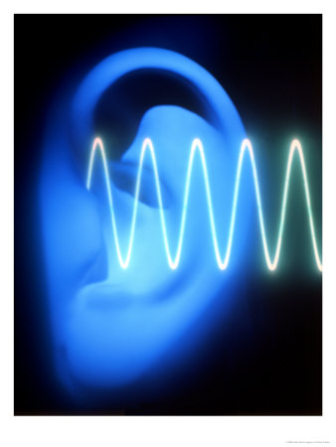
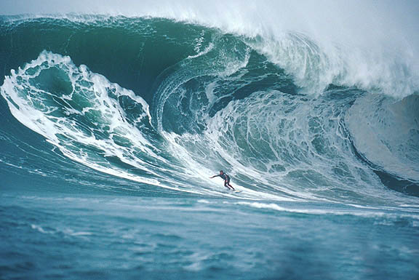
DO NOW (SILENT – 5 MIN)
List as many types of waves as you can think of. What do they have in common? How do you think they work?

Slide 2
]]
An ocean wave is energy traveling through water.

Slide 3
Sound waves and light waves are energy traveling through air.

Slide 4
Quick notes on waves
Waves are traveling energy

Slide 5
Quick notes on waves
Waves are traveling energy
Waves can travel through almost any solid, liquid, or gas

Slide 7
Properties of waves
Wavelength: how long a wave is (of course! ☺) shorter wavelength = higher energy

Slide 8
Properties of waves
Wavelength: how long a wave is (of course! ☺) shorter wavelength = higher energy
Amplitude: how tall a wave is; taller wavelength = higher energy

Slide 10
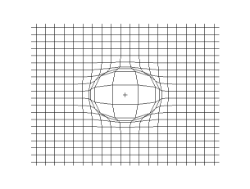

Slide 12
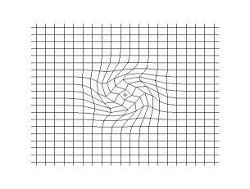

Slide 14
Properties of waves
Wavelength: how long a wave is (of course! ☺) shorter wavelength = higher energy
Amplitude: how tall a wave is; taller wavelength = higher energy

Slide 15
Properties of waves
Wavelength: how long a wave is (of course! ☺) shorter wavelength = higher energy
Amplitude: how tall a wave is; taller wavelength = higher energy
Frequency: how fast a wave is vibrating (in waves per second)

Slide 16
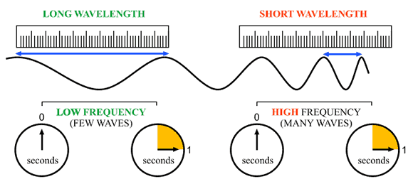

Slide 17
Partner Interviews, Round 1
Talk with the person next to you
Partner A: Explain what wavelength is
Partner B: Explain what frequency is

Slide 18
Partner Interviews, Round 2
Find a person who has shoes the same color as yours to talk to.
Partner A: Explain the difference between wavelength and frequency
Partner B: Explain the difference between wavelength and frequency in a new way

Slide 19
Partner Interviews, Round 3
Find a person who you secretly think is awesome
Partner A: Explain how wavelength is related to the energy of a wave
Partner B: Explain how frequency is related to the energy of a wave

Slide 20
Closing (5 min – SILENT)
1. Use a solid line to draw a medium-frequency, medium amplitude wave.
2. Use a dashed line to draw a high-frequency, low-amplitude wave.
3. Use a dotted line to draw a low-frequency, high-amplitude wave.

