Slide 1
Biodiesel Basics
By C Kohn, Dept. of Agricultural Sciences Waterford, WI

Slide 2
A brief engineering lesson.
A diesel engine is an internal combustion engine that converts chemical energy (in fuel) to mechanical energy that moves pistons up and down inside enclosed spaces called cylinders.
The pistons are connected to the engine’s crankshaft, which changes their linear motion into the rotary motion needed to propel the vehicle’s wheels.
Source: US Dept of Energy

Slide 3
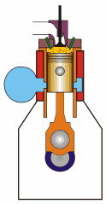
Diesel vs. Gas Engines
With both gasoline and diesel engines, energy is released in a series of small explosions (combustion) as fuel reacts chemically with oxygen from the air.
These explosions push the pistons down, turning the crankshaft.
Diesels differ from gasoline engines primarily in the way the explosions occur.
Gasoline engines start the explosions with sparks from spark plugs
In diesel engines, fuel ignites on its own due to compression
Source: US Dept of Energy

Slide 4
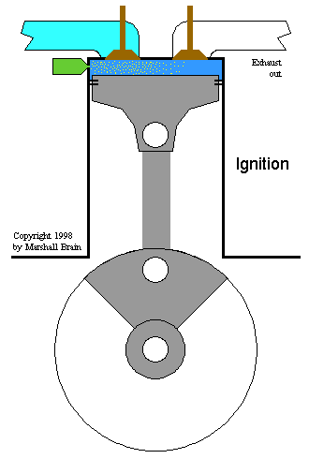
Why Diesel Engines are Efficient
Air heats up when it’s compressed. Fuel ignites w/o a spark if the air is heated to the combustion temperature.
This fact led German engineer Rudolf Diesel to theorize that fuel could be made to ignite spontaneously if the air inside an engine’s cylinders became hot enough through compression.
Diesel engines are very efficient - a fuel that has high energy content per gallon, like diesel fuel, reacts with compressed oxygen to produce a more potent explosion.

Slide 5
Diesel Engine Performance
Diesels are workhorse engines.
That’s why you find them powering heavy-duty trucks, buses, tractors, and trains
The efficiency of a diesel engine comes from compressing the air to raise the temperature, which also increases the concentration and availability of fuel-burning oxygen.

Slide 6
A brief history lesson.
The engine that Rudolph Diesel demonstrated at the World Exhibition in Paris in 1900 ran on oil extracted from peanuts.
The first diesel engine ran on biodiesel!
Diesel eventually switched to petroleum diesel fuel due to the fact that it was a cheap byproduct of kerosene production
With a greater understanding of the disadvantages of petroleum usage, biodiesel is again gaining attention.

Slide 7
What is Biodiesel
Biodiesel is a fuel made by reacting a plant oil or animal fat with an alcohol (e.g. methanol).
This reaction is called transesterification
Transesterification: a chemical reaction in which the carbon groups of an alcohol are swapped for the carbon groups of an ester (such as plant oil or animal fat).
Alcohol + Oil glycerin & biodiesel
Source: Univ. of Montana
Basic Catalyst

Slide 8
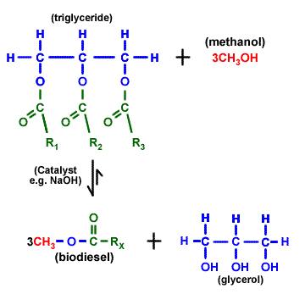
The Chemistry

Slide 9
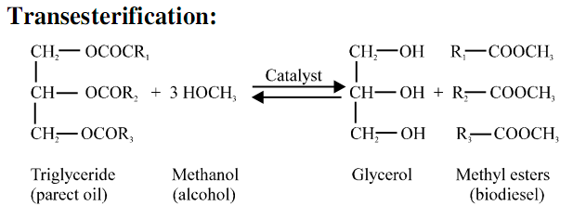
Transesterification
Click here for an animation of transesterification
To oversimplify it, transesterification is a reaction in which the “branching” carbon molecule of an oil or fat is “straightened out” so that it can be more efficiently combusted.
We want our oil or fat to go from a tree-like molecule into straight chains of carbon.
Transesterification accomplishes this task.
From branched…
To Straight

Slide 10
Advantages of Biodiesel
Advantages
1. B100 can be produced from renewable, domestic resources.
2. B100 is energy efficient. (The total fossil fuel energy efficiency of biodiesel is 320% vs. 83% for petroleum diesel.) (National Biodiesel Board, 1998)
3. B100 can be used directly in most diesel engine applications.
4. B100 can reduce global warming and tailpipe emissions (-41%) (Hill, Nelson, Tilman, Polasky, & Tiffany, 2006).
5. B100 is nontoxic and biodegradable.
6. B100 is a good solvent and may clean out fuel line and tank sediments. (Note that this may result in fuel filter clogging during initial use.)

Slide 11
The BIG Advantage

Slide 12
Crop-Biodiesel Efficiency
Soybeans | 40-50 gal/acre
Rapeseed | 110-145 gal/acre
Mustard | 140 gal/acre
Jatropha | 175 gal/acre
Palm Oil | 650 gal/acre
Algae | 10,000-20,000 gal/acre
While chemically all biodiesel is essentially the same, the choice of feedstock (source) will largely affect how sustainable the use of biodiesel can be.
Data: http://www.journeytoforever.org/
Algae data: www.eere.energy.gov

Slide 13
Limitations
Limitations
1. B100 contains roughly 8% less energy per gallon.
2. B100 generally will freeze at a higher temp than conventional diesel (i.e. cold weather use is a problem.)
3. B100 is not compatible with some hose and gasket materials, which may cause them to soften, degrade, and rupture.
4. B100 is not compatible with some metals and plastics.
5. B100 may increase nitrogen oxide emissions (NOx is a GHG)
6. It requires a great deal of land, which could lead to increased deforestation; we just don't have enough material for this to serve more than a small proportion of our transportation energy needs.
7. Even small quantities of water can affect biodiesel, making it less efficient and potentially dangerous in wet conditions.
8. Because it is biodegradable, biodiesel has an expiration date (i.e. it spoils),
Source: Purdue Univ.

Slide 14
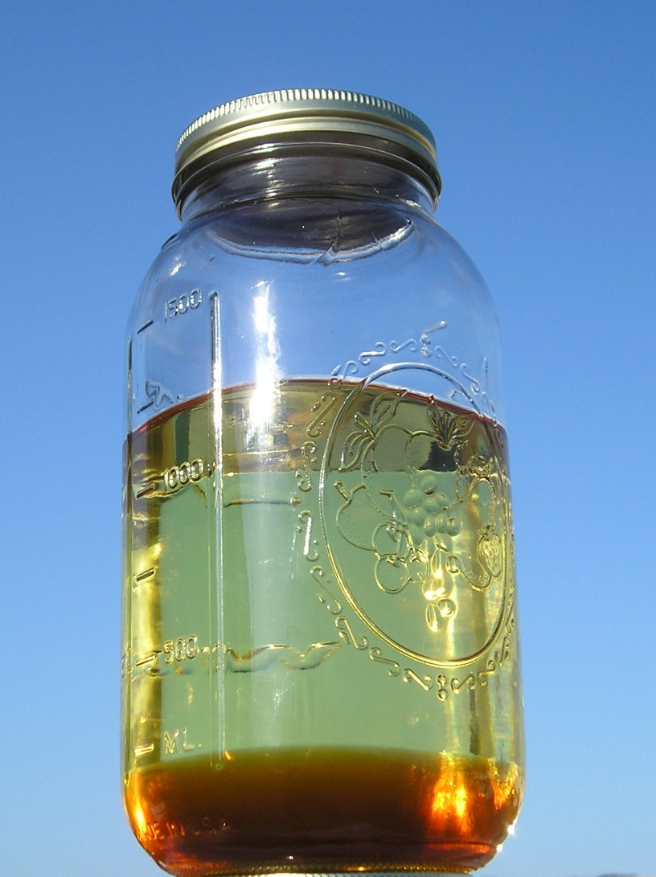
Stages of Biodiesel Production
1. The reaction
The lighter biodiesel stays on top and the heavier, darker glycerin settles to the bottom
Glycerin can be used as a byproduct for soaps, lotions, etc.
~90% will be biodiesel.
Source: Univ. of Montana
Notes:
Pass out jars with each stage

Slide 15
Stages of Biodiesel Production
2. The Washing
Washing the biodiesel removes all the impurities
Glycerin
In-completely reacted oil
Methanol
Lye
Soaps
Source: Univ. of Montana

Slide 16
Stages of Biodiesel Production
3. The Drying
All the water needs to be evaporated
The difference in clarity is visible with the removal of the water
Source: Univ. of Montana

Slide 17
Stages of Biodiesel Production
4. The Testing
Standards of quality have been established to prevent engine damage
These standards focus on:
A) if there are contaminates in the fuel and …
B) if the oil or fat completely reacted in the transesterification.
Univ. of Montana

Slide 18
Concluding Thoughts
Though the implementation and use of biodiesel in the United States are significant steps forward, it is critical to understand that biodiesel is only a partial solution to our fuel problem.
If we converted all U.S. soybean acres to biodiesel, we would only replace 6% of the U.S. demand for diesel (Hill, Nelson, Tilman, Polasky, & Tiffany, 2006).
We may, someday, be able to engineer microorganisms to produce biodiesel from cellulose.
In the meantime, we must continue to look towards new sources of fuel to decrease our reliance on petroleum-based fuels. Source: Purdue Univ.

Slide 19
Our Focus
Week 1: we will focus on the production of biodiesel from pure vegetable oil (PVO)
Week 2: we will focus on the production of biodiesel from waste vegetable oil (WVO).
Week 3: we will focus on the quality of our biodiesel, testing standards, and selection of feedstocks.

Slide 20
Week 1: Overview
Part 1: Processing the oil
We will add methoxide (methanol and potassium hydroxide) to oil already heated to 55º C.
KOH is extremely caustic; gloves, aprons, and goggles will be needed at all times.
If you are missing one or more of these three, the first time is a warning, the second time is removal from the lab (we can’t take that chance).
The heated oil and methoxide will be stirred (on the mag stirrer) and kept warm for 45 minutes.
At the end of class, the heaters will be turned off and the mixture will be allowed to settle for 24 hours.

Slide 21
Week 1: Overview
Part 2: Separating and washing the biodiesel
After the solution has completely cooled and settled, you should notice a clearish yellow fluid on top of a brownish layer of glycerine.
This entire fluid will be poured into a separatory funnel.
The glycerine will be allowed to settle to the bottom; turning the knob will allow the glycerine to flow into your waste jar.

Slide 22
Week 1: Overview
Part 2: Separating and washing the biodiesel (cont)
After we remove all of the glycerine, we will add 50-100 ml of water to wash out any impurities.
The water absorbs leftover glycerine, KOH, and methanol.
The water will sink to the bottom and can be removed by turning the sep. funnel knob.
This usually must be repeated two more times.
You can stop when the pH of your wash water is 7

Slide 23
Week 1: Overview
Part 3: Drying (24-48 hrs)
We will allow the biodiesel to stand for 24 hours after the final wash so that excess water can evaporate or settle to the bottom (where it can be drained).
The finished product will be stored in glass mason jars for later testing.
We NEVER want to use plastic to store biodiesel!

Slide 24
Week 2: Biodiesel from WVO
During week two, we will make biodiesel from Waste Vegetable Oil
This is more challenging because we will have to calculate how much KOH is needed to completely react all of the Free Fatty Acids (FFAs) created by the use of the veg oil
This will be done via titration (drop by drop addition of a chemical until a color change is detected).

Slide 25
Final Note
Biodiesel production can be very dangerous!
You are working with an explosive, combustible substance made with highly corrosive and toxic chemicals.
While biodiesel is generally non-toxic, the substances that are use to make it are not!
ONLY PRODUCE BIODIESEL UNDER THE DIRECT SUPERVISION OF YOUR INSTRUCTOR IN A CONTROLLED LAB SETTING!!!!!!!
DO NOT use online labs involving plastics (e.g. Coke Bottle Biodiesel) – biodiesel can react harmfully with plastics and harm or kill you!

