Slide 2
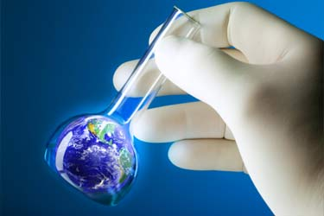
Breakthroughs in Agricultural Science
Agricultural Science
Independence High School

Slide 3
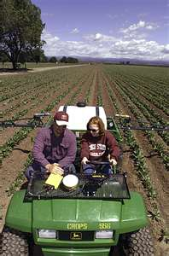
Yesterday we came up with many popular agricultural innovations.
Today I would like to discuss a few more that we didn’t cover…

Slide 4
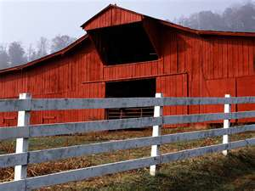
#1- Animal Immunization
Diseases devastated all types of agriculture animals until the 1870’s.
Louis Pasteur experimented with vaccinating animals.
Found that animals that survived a type of disease created an immunity to it.
He took blood from a sheep that survived anthrax, and separated the serum from the blood.
His experiment consisted of 2 groups of sheep
Group 1→ Injected with serum. Later injected with anthrax
Group 2 → Only injected with anthrax

Slide 5
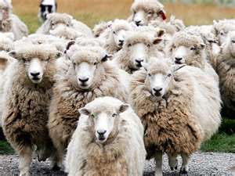
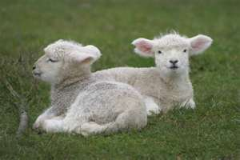
What do you think happened?
The group that received the serum remained healthy, while the group that did not died.

Slide 6
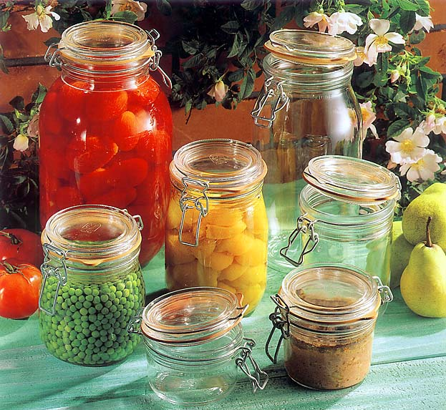
#2- Canning & Refrigeration
Problems:
When a large animal was slaughtered, not all of it could be eaten without it spoiling. Later animals were shipped live to slaughter houses in urban areas by railroad…
Fresh fruit in summer spoiling quickly.
Salting/Drying food was common, but not practical.
1800- French Gov’t offered a prize to preserve food for long periods for army.
Nick Appert developed a process of placing food in glass bottles and heating bottles in hot water bath. He sealed tops with corks and wired them closed.

Slide 7
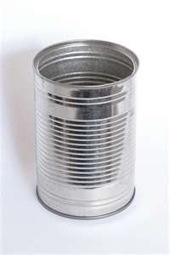
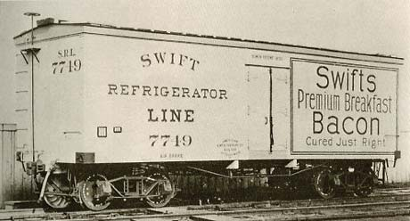
The heating killed the microorganisms, and the seal prevented other microorganisms . Food stayed edible for months.
Appert died before understanding why this worked…
In 1810, the Tin Can was invented, and “Canning” was revolutionized.
People Cut ice from lakes and used ice-boxes until the 1880’s, when refrigeration was developed.
The refrigerated railcar was invented
in 1906 to allow fresh meat & fruit anywhere
in the country, and at any time of year.

Slide 8
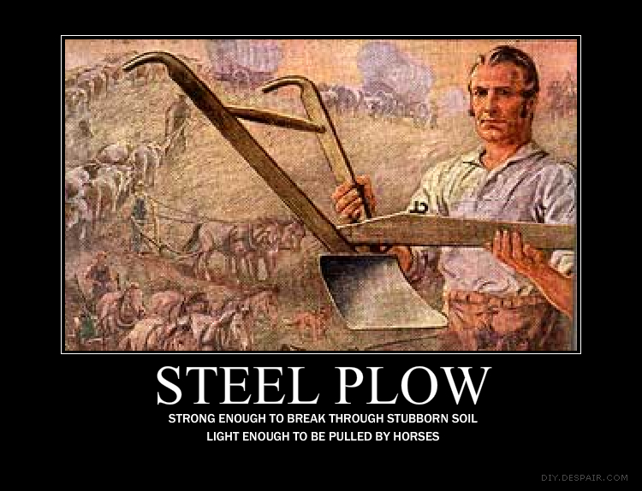
#3- Ag Mechanization-
Wooden plows and iron plows were used for many years, but were insufficient.
John Deere invented the steel plow, which were lighter and stronger.
This opened up
millions of acres
to now be farmed.

Slide 9
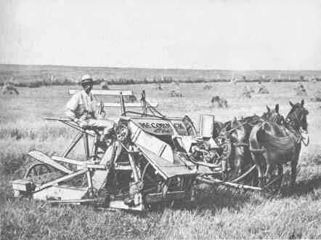
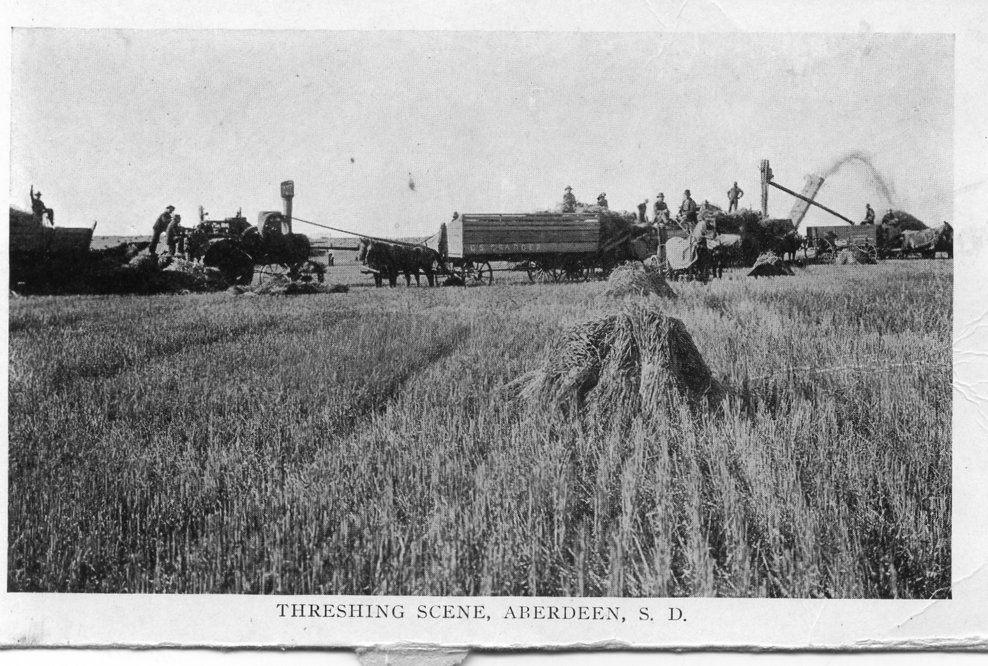
Ag Mechanization…
Big Advancements came during the Industrial Revolution, including:
Interchangeable Parts
Cyrus McCormick- Wheat Reaper- (1931)
Steam Powered Threshing Machine

Slide 10
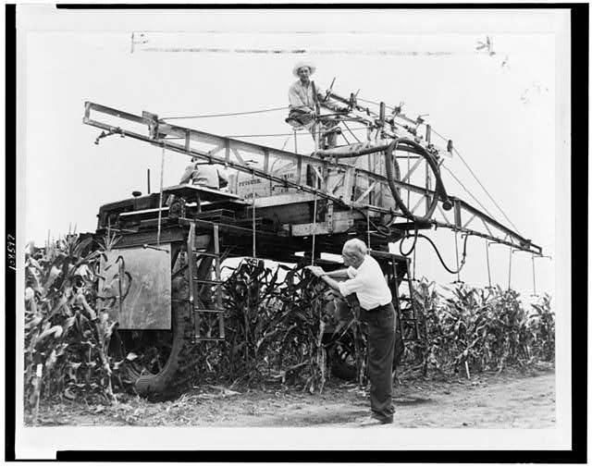
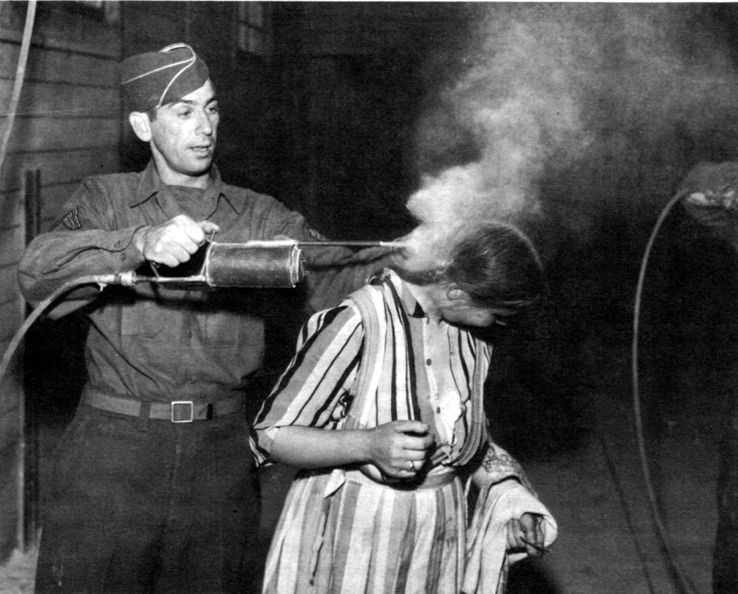
#4- Pesticides
Used to kill insects, rodents, weeds that destroy crops.
If applied properly, they can protect crops and livestock & pose little threat to humans.
Have had a bad reputation for damaging the environment.
Applied DDT to Prevent polio & malaria, along with other diseases…

Slide 11
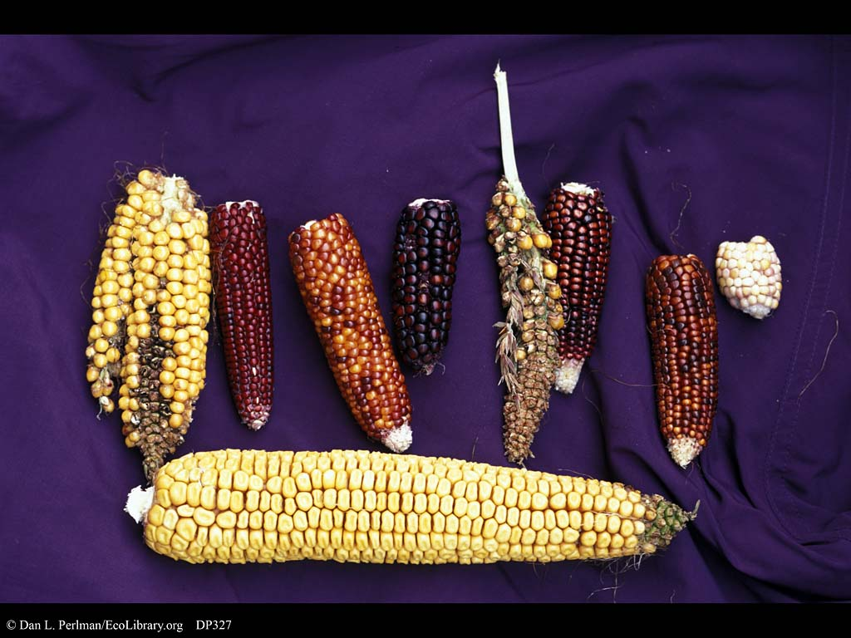
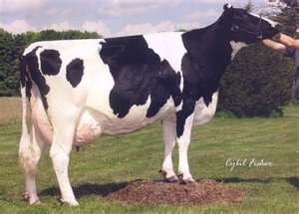
#5- Genetics
Many advancements due to genetics, or how characteristics are passed onto the next generation.
New and improved varieties of crops have doubled and tripled yields.

Slide 12
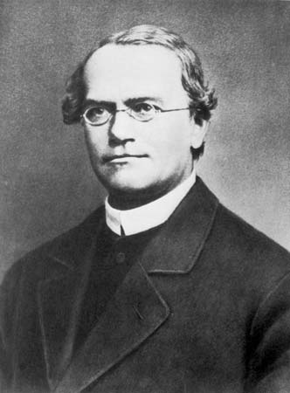
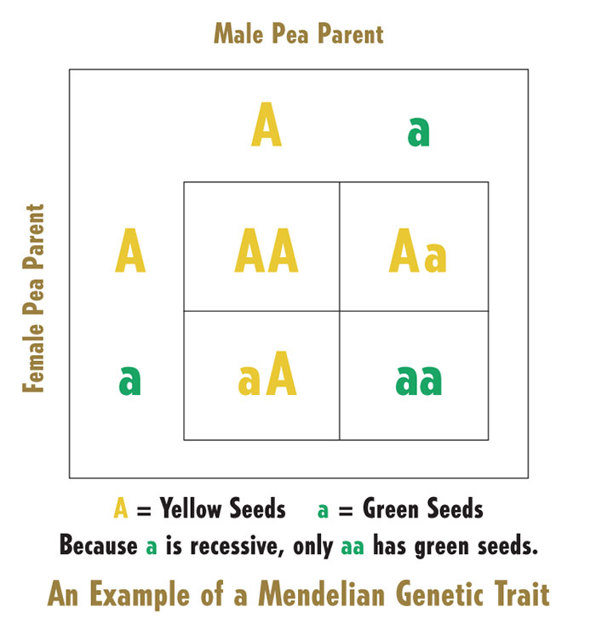
Genetics, Continued-
Gregor Mendel, Austrian Monk, studied “inherited characteristics” of garden peas, now called “genes”.
Most of Modern research is based on Mendel’s theories from the 1850’s.

Slide 13
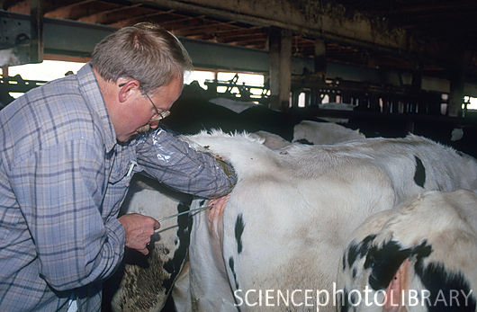
#6- Artificial Insemination- (AI)
1930’s- Through the techniques of animal semen collection, storage, and distribution, every producer has access to the best genes in the industry. Most dairy cattle born today are the result from AI.

Slide 14
#7- Embryo Transfer (ET)
Embryo Transfer is basically the multiple injections of hormone to multiply the ovulations in the cow that you want to get the embryos from.
Cow is inseminated 3-4 times, about 12 hours apart
Seven days later the uterus is flushed to extract the embryos .
The good embryos are isolated using a microscope and then transferred into the recipient cows or frozen.

Slide 15
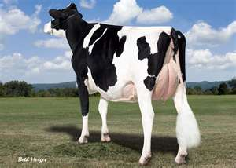
Embryo Transfer allows producers to:
Produce up to ten or more progeny per year from their best cows.
Profit from the increased sale of quality genetics without losing the bloodlines.
Extend the productive life of some older cows, incapable of carrying another calf.

Slide 16
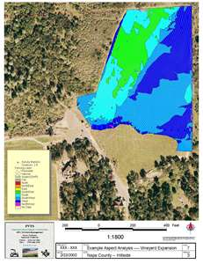
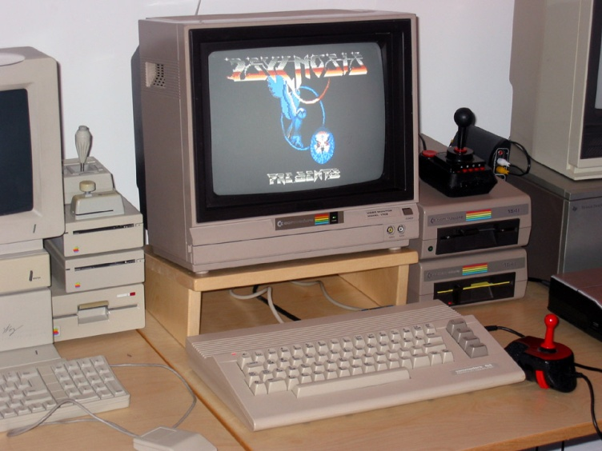
#8- Computer Use
Invented in 1940’s, but not integral part of daily life until 1980’s.
84% of farms have computers
Data can be analyzed in seconds instead of days or weeks
Feed formulation is done by computer to control mixing of ingredients.
Commodore 64- mid 1980’s

Slide 17
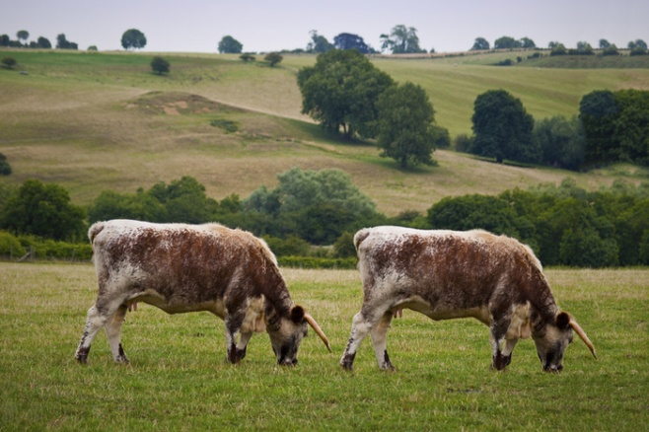
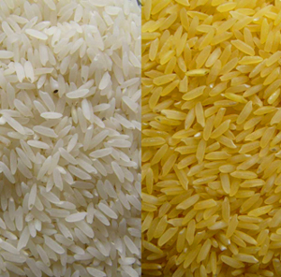
#9- Genetic Engineering
Process of removing and inserting genetic material into living organisms.
Have the potential to remove any bad characteristics and add good ones.
Scientists have genetically mapped many plants and animals…
Controversy- Is this ethical and the right thing to do?
Examples: Cloning, Bt Corn (resists pests), insulin for diabetes
Cloning
Golden Rice

Slide 18
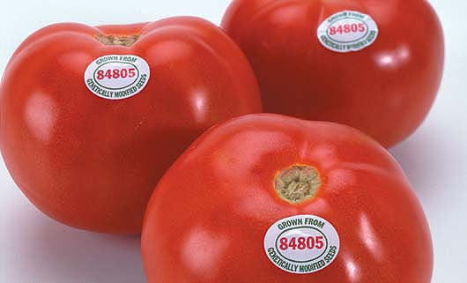
First GMO Fruit- Flavr Savr Tomato-
Came out in 1994
Added a gene that interfered with an enzyme that causes rotting.
Slow Ripening Process= Long Shelf Life
Could pick tomatoes when red instead of green, giving more flavor.
Taken off market in 1997 due to consumers were scared.

Slide 19
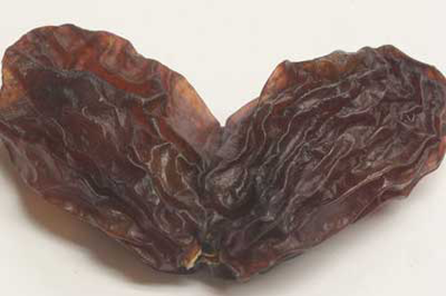
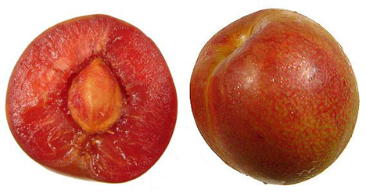
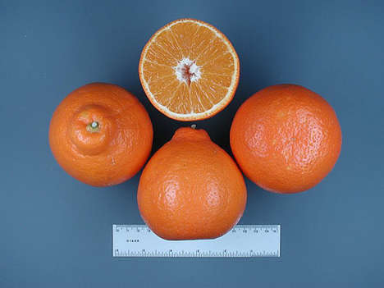
Some GMO Fruits-
Graisins- Developed in Japan to grow twice the normal size.
Pluots- Plums and apricots cross. Heavily fortified with Vit. C, no sodium or cholesterol.
Tangelo- Tangerine x grapefruit

Slide 20
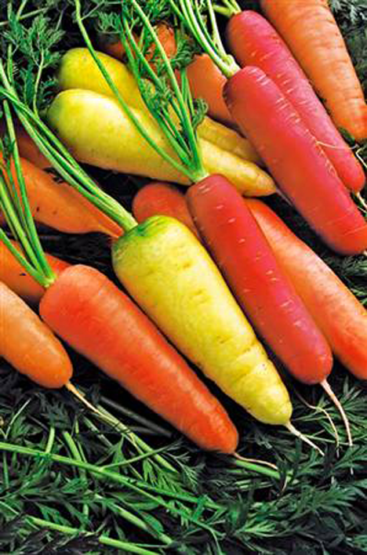
Colored Carrots?
Could colorful, genetically-modified carrots like those pictured here be the secret to absorbing more calcium?
Two Texas researchers say yes – and they’ve created a carrot they claim allows people to absorb 40% more calcium than normal carrots to back up their claims!

Slide 21
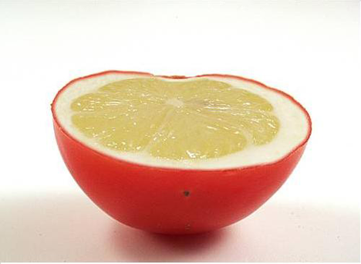
Lemons + Tomato = Lemato?
A lemon and a tomato aren’t the most natural of pairs, but that didn’t stop Israeli researchers from bringing us the Lemato!
Unlike other genetically altered fruits and veggies (which were created primarily for health reasons), it appears that the lemato was solely an experiment to determine if it was possible to make tomatos give off the scent of lemons. Mission accomplished!

