Slide 1
Chapter 1
The Plant Kingdom

Slide 2
Plants are cool…because:
Manufacture their own food
Have continuous type of growth readily modified by environment
Possess less definite form than animals when mature
88% of world’s total calorie intake comes from plants!
80% of world’s protein intake comes from plants.

Slide 3
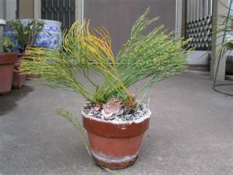
Plant Evolution
400 million years ago—earliest land plants, similar to “whisk fern” (Psilotum)
350 million years ago—first seed plants, seed ferns
120 million years ago—first flowering plants (now make up about 2/3 of all plants)

Slide 4
Geographical Distribution (pg. 4)
Climate has most important effect on plant distribution/structural adaptations.
Greatest number of species is near the equator; smallest number near poles.
Biome: large areas with characteristic vegetation and animal species, such as tropical rain forest, desert, and tundra.

Slide 5
4 Main Roles of Plants:
Edible plants-(Whole plants or portions of plants, such as seeds and fruits)
Industrial uses— There are several important products produced from plants, such as wood, fibers, oils, and rubber.
Medicinal uses—
Oils— Many plants store oil as a food reserved in the seeds and fruits of the plant.

Slide 6
Taxonomy (Classification System) Plants can be classified many ways, including…
Phylogenetic—how plant looks
Environmental—where plant grows
Agricultural—what use plant is grown for
Natural/morphological—how plant’s structure compares to other plants

Slide 7
2 Plant Kingdom Divisions
Thallophytes—lack true roots, stems, leaves, 10+ divisions of algae and fungi
Embryophytes—include two groups:
Bryophytes: no vascular tissues, simple in structure
Vascular plants: true roots, stems, leaves

Slide 8
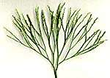
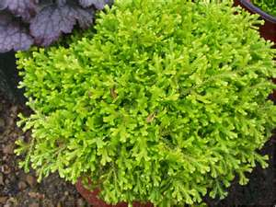
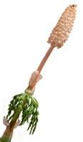
Seven Vascular Plant Divisions
Four divisions represented by very few species:
Psilotophyta (only three living species)
Lycopodiophyta (club mosses)
Equisetophyta (horsetails)
Rhyniophyta (fossils)…extinct

Slide 9
Seven Vascular Plant Divisions (continued)
Last three divisions, today’s vegetation:
Polypodiophyta—ferns
Pinophyta—cone-bearing gymnosperms*
Magnoliophyta—true flowering plants, or angiosperms*
*Collectively known as spermatophytes, or seed plants

Slide 10
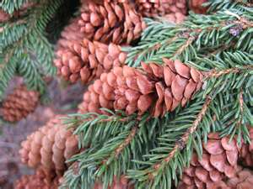
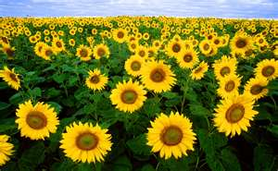
Spermatophytes (Seed Plants)
Gymnosperms—“naked-seeded,” woody, perennial, mostly evergreen, represented principally by cone-bearing trees (conifers)
Angiosperms—have flowers and seed always protected by fruit, further divided into two subdivisions

Slide 11
Two Subdivisions of Angiosperms
Monocotyledon—one cotyledon (seed leaf); e.g., bamboos, palms, grasses, cattails, lilies, irises, orchids, bananas, bromelaids
Dicotyledon—two cotyledons; e.g., willows, poplars, roses, southern magnolias, honeysuckle, allemanda

Slide 12
Lower Subdivisions
Order
Family
Genus
Species
Variety-cultivar-clone

Slide 13
Binomial (Two-word) Nomenclature
Genus
Species
Based on flowers and/or reproductive parts of plant; flower is plant part least influenced by environmental changes

Slide 14
Research
New taxonomic tools include
chemical analysis of plant composition
protein analysis of plant
DNA analysis—genetic fingerprinting

