Slide 1
Habitats
By Craig Kohn, Waterford, WI

Slide 2
Habitat Definitions
A habitat is the place where a population of a species lives.
A population is a group of living organisms of the same kind living in the same place at the same time.
All of the populations interact and form a community.
A community is group of interacting living species sharing the non-living resources of a specific area
The interaction of the living species of the community and the non-living resources is an ecosystem

Slide 3
Habitat Function
The habitat must supply the needs of organisms, such as food, water, temperature, oxygen, and minerals
When a habitat ceases to be able to do this, it ceases to be a suitable habitat
Every living species occupies a niche, or particular role in a habitat
E.g. bees fill a reproductive niche for flowers
Wolves fill a predatory niche that improves the genetic quality of a herd of elk
A habitat has a limited amount of niches to fill.
Because of this, competition, predation, cooperation, and symbiosis occur.

Slide 4
Niche Interactions
Competition – when two species compete for the same resources; one wins, one loses
E.g. Lions and hyenas
Predation - when one species is consumed by another species for resources that it already consumed
E.g. Wolves and elk
Cooperation – when two species obtain resources through a mutual relationship
E.g. leaf-cutter ants and fungus
Symbiosis – when two species cooperate to the extent that they each become completely dependent on each other
E.g. bacteria in a cow’s rumen; both need each other to function

Slide 5
Components of a Habitat
Abiotic Resources
Nonliving resources
Biotic Resources
Living components of a habitat
Structure
Plant life components
Succession
Change, and rate of change, of a habitat

Slide 6
Abiotic Resources
Abiotic resources are the non-living components of a habitat
These include air, water, sunlight, minerals, etc.
This could also include the terrain of a habitat, the weather patterns, and the climate

Slide 7
Biotic Resources
These are the biological aspects of a habitat, including –
Food: the resources needed for the energy demands of populations in a habitat
Populations: the numbers of different living species
Community: the types of different living species
Fertility: the capacity for growth and development in a habitat
Biodiversity: the numbers of individuals and species in a habitat

Slide 8
Structure
The shape, height, density, location, and diversity of a habitat’s plant life.
The combination of these factors create…
Cover: areas to shelter living species (esp. wildlife)
Corridors: connections between different areas of the same habitat
Feeding areas: places in which wildlife can graze, forge, or hunt

Slide 9
Structure & Habitat Health
Habitat health is not just a matter of size but also quality
For example, moose populations in eastern Canada were wiped out by clear-cut forestry
Research found that moose could not tolerate the loss of more than 0.5 square miles (Peek)
However, even the loss of a specific kind of species (without removing the rest of the vegetation) could cause losses in moose populations.
E.g. only removing coniferous trees was still harmful

Slide 10
Succession
Succession is the natural process of change and transition in a habitat
E.g. a pond will eventually fill in with sediment to become a marsh.
The marsh will eventually dry into a meadow.
The meadow will become scattered with shrubs and then trees.
Eventually a full forest will occupy the same area and may remain until it is destroyed by a major natural process (fire, flood, glacier, volcano, etc.)
Succession occurs over thousands of years; it is a slow process

Slide 11
Case Study: Wild Turkeys
Turkey populations increase dramatically as plant succession occurs in deciduous forests (Peek, Review of Wildlife Mgmt)
As young forests age into mature hardwood stands, turkey numbers increase rapidly.
Mature, open forests of mixed species create the most secure populations of wild turkeys
Mature hardwood forests are key for turkeys
Under intensive logging or suburban sprawl, turkey populations plummet
Human expansion is especially bad in April-June during nesting

Slide 12
Succession vs. Disturbance
Succession is very different from human disturbance.
Succession is slow and enables populations to move over time to new habitats that are more suitable
Habitat disturbance and destruction is rapid; living species cannot adapt to the pace at which the habitat changes
This causes species loss
Habitat destruction is the greatest cause of extinction

Slide 13
Measures of Habitat Health
Biodiversity
Patchiness
Edge
Fragmentation

Slide 14
Biodiversity
Biodiversity is a measure of habitat health
The higher the biodiversity, the more secure the habitat
E.g. think of the Irish Potato Famine; the lower the diversity of the food supply, the greater the threat to that species’ population
Biodiversity is maximized when habitat size is maximized

Slide 15
Patchiness
Patchiness is how “broken up” a habitat is
I.e. is the habitat solid or more like a checkerboard
The more “solid” a habitat, the better
Imagine a drinking glass
It works far better if it is in one piece
A glass might hold some water in its shards, but it works far better as a single piece
The same is true for a habitat
We want to avoid “shattering” our habitats

Slide 16
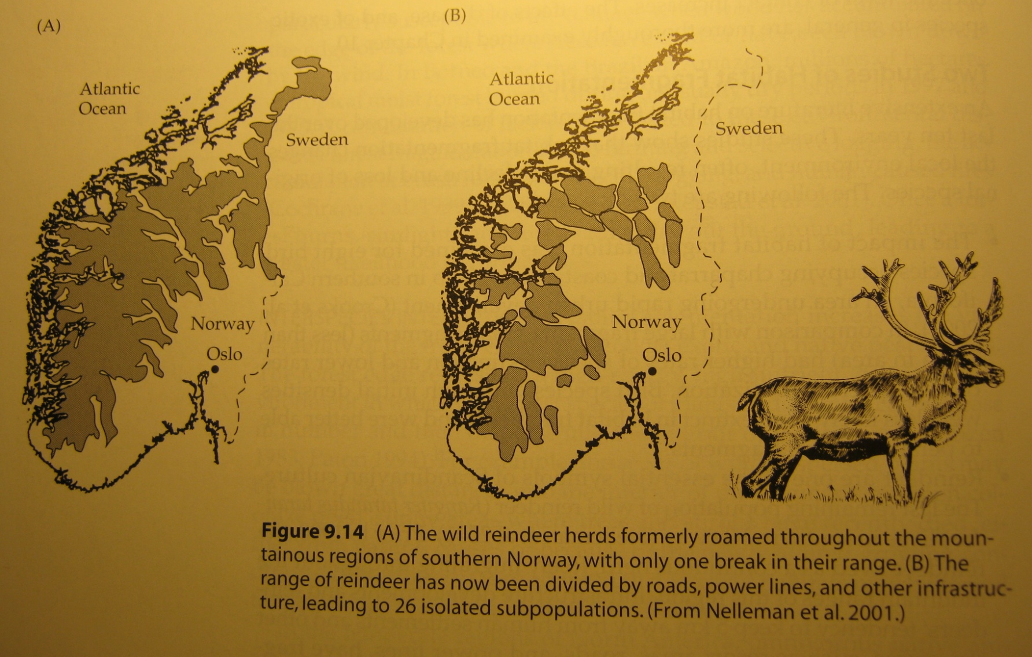
From One to 26

Slide 17
Edge
We want to maximize the amount of isolated interior portions of a habitat
Edge is the amount of borders that exist on a particular habitat.
More edge habitat = less interior habitat
E.g. a round habitat has less edge than a long narrow habitat
Edge almost always has low biodiversity while the interior has high biodiversity

Slide 18
Which has more edge?

Slide 19
Detrimental Edge
The habitat edge is usually the most altered and damaged portion of a habitat. For example…
The edge has the greatest temperature changes
Edge has the most invasive species
E.g. Buckthorn and Garlic Mustard prevalence
Edge is the most affected by pollution
Edge is the most damaged in storms
Edge is the most likely to be lost in fire
Edge is the most likely to be affected by disease
E.g. Emerald Ash Borer

Slide 20
Fragmentation
Fragmentation is the measure of how much edge and patchiness affects a habitat
The immediate impact of fragmentation is that the surviving species will “huddle” in what remains of their habitat
Biodiversity may initially increase because of this concentration of species
Over time, species will be slowly lost
Higher Fragmentation = Lower Biodiversity

Slide 21
Which is more fragmented?

Slide 22
Effects of Fragmentation
Why are species lost when a habitat is fragmented?
Many bird, mammal, and insect species will not cross even short distances to reach a new habitat
Populations of species will become isolated and genetic diversity will be reduced
As species are lost, their niche will not be filled by new populations and the niche will not be filled
Species dependent on the niche will also be lost
This creates a sort of extinction domino effect

Slide 23
Effects of Fragmentation
Island Biogeography Model: large areas have more diversity and more species than small areas
As habitats are split up, populations become isolated from each other, reducing the availability of diverse genomes from mating pairs
Reduced genetic diversity = increased species susceptibility
As habitats become split up, the availability of species to fill a needed niche are lost.
As habitats shrink, so does genetic diversity and species biodiversity
As biodiversity decreases, species are lost at faster rates due to disease, predation, competition from invasives, etc.
If a species is lost in a small habitat, the other species dependent on that species are also lost.
A road dividing a habitat in half causes far more damage than is immediately obvious. Why? TPS

