Slide 1
Precision Measurement
Jason Hovell
Small Engines Technology Independence High School

Slide 2
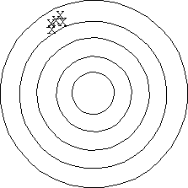
Precise, But Not Accurate
This is a precise pattern, but not accurate. The darts are clustered together but did not hit the intended mark.

Slide 3
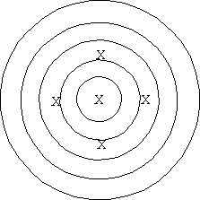
Accurate, But Not Precise
This is an accurate pattern, but not precise. The darts are not clustered, but their 'average' position is the center of the bull's eye.

Slide 4
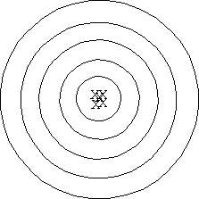
Precise and Accurate
This pattern is both precise and accurate. The darts are tightly clustered and their average position is the center of the bull's eye.

Slide 5
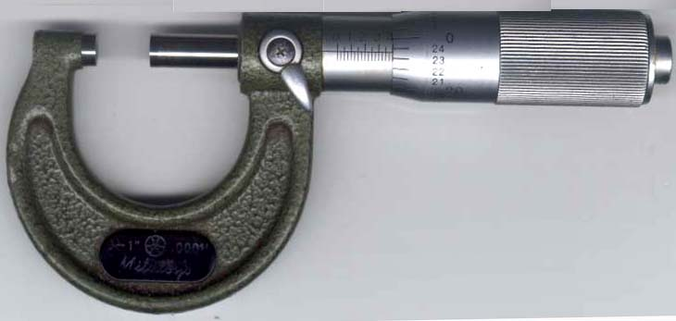
Measuring
Instruments
Micrometer
Parts
Ratchet
Anvil
Spindle
Sleeve
Thimble
Frame

Slide 6
Let’s view this following interactive website together to see how a micrometer works…
http://www.wisc-online.com/objects/ViewObject.aspx?ID=MTL1902

