Slide 1
Why Biofuels?
By C Kohn, Waterford WI

Slide 2
What’s the problem?
“It's inevitable. But just how soon will [oil] become so scarce and expensive that we're forced to make hard choices about how we live?”
“In the end the quest for more cheap oil will prove a losing game.”
“[This is] not just because oil consumption imposes severe costs on the environment, health, and taxpayers, but also because the world's oil addiction is hastening a day of reckoning.”
– Source: National Geographic, 2005

Slide 3
Fossil Fuels
Fossil fuels - coal, oil and natural gas -- provide more than 85% of all the energy used in the United States. (Site: DOE)
Fossil fuels developed from plants and animals that died millions of years ago and collected on the bottom of ocean seabeds.
The accumulation of pressure and temperature turned organic carbon into simpler forms of hydrocarbons.
Other elements were “squeezed” out of the molecular structure of organic carbon by this intense heat and pressure.

Slide 4
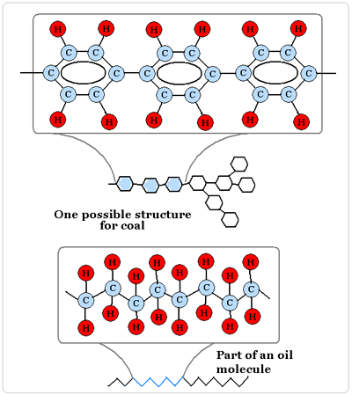
Hydrocarbon
A hydrocarbon is simply a chain of hydrogen and carbon.
Each kind of hydrocarbon will have different proportions of hydrogen and carbon.
Petroleum is a blend of many different kinds of hydrocarbons.
Refined petroleum will produce gasoline, diesel fuel, kerosene, asphalt, and other forms of fossil fuel

Slide 5
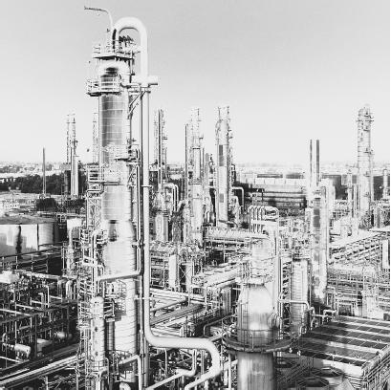
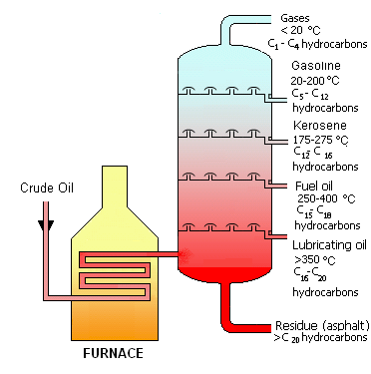
Different petroleum products have different boiling points.
Heating each products past its boiling point enables each product to be separated based on this property.

Slide 6
(Natural) Gases , e.g. Propane: hydrocarbons containing 1 to 4 carbon atoms in each molecule. These can be used for fuels or for plastics and synthetic fibers.
Gasoline : Probably the most familiar of the hydrocarbon distillates is gasoline. Gasoline consists of hydrocarbons with 5 to 12 carbon atoms in each molecule.
Kerosene: Kerosene consists of hydrocarbons containing between 12 and 16 carbon atoms per molecule.
Fuel Oil : Fuel Oils consist of hydrocarbons ranging between 15 and 18 carbon atoms per molecule (includes diesel fuel)
Lubricating Oil : Lubricating oils consist of 16 to 20 carbon atoms per hydrocarbon molecule. Lubricating oils are used to decrease friction between moving parts.

Slide 7
Petroleum
When a hydrocarbon fuel burns completely, the oxygen in the air combines with the hydrogen to form water (H₂O) and with the carbon to form carbon dioxide (CO₂).
“Burning”, or combustion, is simply a matter of rearranging hydrocarbon and oxygen molecules into CO2 and H2O.
Combustion is an exothermic reaction – it is a reaction that releases energy (which you can feel as heat and see as light)
Endothermic reactions would be like instant ice packs, which feel colder when they react because they absorb energy.

Slide 8
Combustion – Bond Breaking
Combustion is the process of breaking atomic bonds and creating new, lower-energy molecules in order to release energy in the form of light and heat.
The energy contained in the bonds of a hydrocarbon molecule is greater than the energy contained in the bonds of CO2 and H2O molecules.
By “rearranging” these atoms, we create a new molecular arrangement in which less energy is needed (and therefore is given off).
This “leftover energy” is given off in the form of heat and light.
The more “emitted energy” there is from burning a fuel, the higher the quality of that fuel.

Slide 9
Rearrangment Reaction
However, this “rearrangement reaction” never occurs completely – some carbon atoms remain “stuck” to each other.
Rather than completely converting into CO2 and H2O, some of the carbon remains unchanged.
This is what creates the carbon monoxide, soot, and smog associated with automobile exhaust.
The byproducts that form from the burning of fossil fuels are very dangerous, can exist in the air for up to several weeks and can travel for miles.
Source: Univ of Mich

Slide 10
Air Pollution
These particles, sometimes smaller than 10 microns in diameter, can reach deep within the lungs.
Particles that are even smaller than this can enter the blood stream, irritating the lungs and transport toxic substances such as heavy metals and mutagens into the body.
Over a lifetime of continued exposure, a person's ability to transfer oxygen and rid their body of pollutants is reduced.
Source: Univ of Mich

Slide 11
An Incomplete Burn
Biofuels usually have a slightly different molecular structure- this is one of the reasons that these fuels are less polluting than gasoline and diesel
Biofuels tend to have simpler molecular structures.
These simpler molecules are easier to “rearrange” more completely during combustion in an engine, so that less carbon monoxide, soot, and unburned hydrocarbons come out the tailpipe afterwards.
Simply put, biofuels burn cleaner because they burn more completely.
The oxygen in ethanol helps E10 burn cleaner (which is why it was first used as an oxygenate)
However, air pollution is not the biggest concern. Even if a petroleum hydrocarbon fuel could burn completely, we still have a bigger problem: greenhouse gases, specifically carbon dioxide.

Slide 12
Carbon Dioxide
Carbon dioxide is a molecule consisting of a carbon double bonded to two oxygen atoms.
Traditionally, carbon dioxide was never a problem
Whatever was produced through respiration and burning was offset by CO2 absorbed through photosynthesis
This kept CO2 between 200-300 ppm for hundreds of thousands of years
CO2, at naturally occurring levels, is vital part of the carbon cycle
However, just like too much rain can cause a flood in the water cycle, we now have a flood of CO2 in the atmosphere.

Slide 13
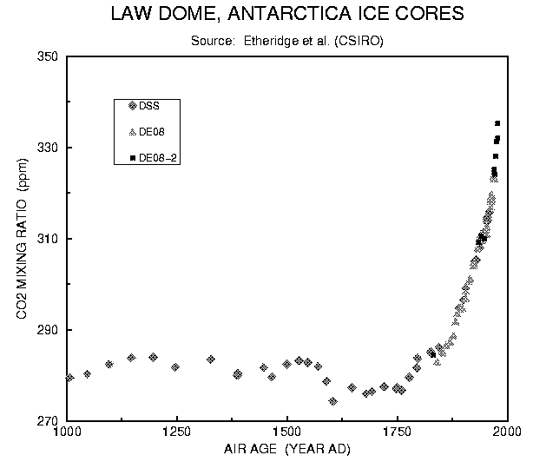
A Flood of CO2
Today, CO2 levels (at 395 ppm) are far past their natural atmospheric levels of 250 ppm naturally.
This should make sense – we are creating millions of years worth of carbon dioxide every time we use fossil fuels while doing nothing to remove this extra carbon.
When we use petroleum, we are creating CO2 at a rate far faster than it can be used.
So why is this a concern?

Slide 14
CO2 – Molecular Insulation.
A CO2 molecule can absorb infrared radiation from the sun, and then release it again.
The now-released radiation will be absorbed by yet another greenhouse gas molecule and then another and then another.
This is sort of like a game of hot potato, but with radiation.
This absorption-emission-absorption cycle serves to keep heat near the surface of the earth.
Excess CO2 is a problem because it prevents an adequate amount of energy from dissipating into space, raising surface temps.
http://www.ucar.edu/learn/1_3_1.htm

Slide 15
What’s Wrong with Gasoline?
It is changing the carbon cycle: worldwide, roughly a third of human-caused CO₂ emissions are the result of transportation – we’re flooding our atmosphere with carbon, and the impact is becoming noticeable
Greenhouse gas levels are dramatically higher now than they’ve ever been in at least the past 500,000 years.
2010 – warmest year ever recorded.
The ten warmest years on record have all occurred in the past 12 years.
The rate of temp change is at least 10-15x the natural rate of change.
Observable and measurable changes are already occurring globally.
We’re mostly to blame: The US accounts for 25% of carbon emissions despite having only 5% of the world’s population (i.e. each American contributes 5x their fair share of CO2)
It’s polluting our air: other gases, such as nitrogen oxides, soot, smog, and CO are also emitted in the exhaust.
It won’t last forever: someday we’ll run out of cheap gasoline, and probably during our lifetimes.

Slide 16
The Benefits of Ethanol
It can reduce our CO2 impact: in 2004 U.S. ethanol use reduced CO₂ equivalent greenhouse gas emissions by 7 million tons; E85 emits 72% less CO₂ per km than gasoline.
It is renewable: we will always have a supply of fuel growing outside our doors.
It is carbon-neutral: the sources of ethanol absorb CO2 from the atmosphere during photosynthesis. Whatever is released during combustion is reabsorbed when the ethanol plant-sources are grown again.
We gain net energy from its production: it takes less energy to manufacture ethanol than is acquired from the combustion of ethanol.
It’s cleaner: ethanol burns cleaner because it burns more completely than gasoline
It’s Made in America: we make it here, and the money we pay stays in the US, helping US Agriculture and businesses.
Notes:
7 million tons is equivalent to removing the emissions of 1 million cars

Slide 17
The Disadvantages of Ethanol
What is the impact of using food for fuel and is it ethical?
Do we have enough land to grow the sources of ethanol?
Can we grow the plants in an environmentally friendly way?
Ethanol cannot be transported in pipelines (at this time); this raises transport costs.
There is uncertainty about the economic feasibility - do we have enough land, farmers, and income generated for producers? Will business take this risk?
Ethanol is less energy-dense per gallon than gasoline, translating into a reduced number of miles per gallon (although this could change with newly engineered engines)
Sources: Univ of Mich, GLBRC

Slide 18
Ten 10% Solutions
It’s clear that ethanol is not the solution by itself – it will not solve 100% of our problem.
To solve the American energy crisis, we’ll need more than one solution.
If each solution solves 10% of the problem, it will take ten different solutions to completely solve the problem.
Another one of these “Ten 10%’s” may be biodiesel.

Slide 19
What is Biodiesel?
Biodiesel: An alternative renewable fuel that can be made from a plant oils or animal fats.
Biodiesel is similar to diesel fuel, and is very effective for running diesel vehicles and for heating.
It can be blended with petroleum diesel at any concentration or used in its pure form, B100.
Little modification is needed for diesel engines to run on biodiesel (short of the fuel filter).
Source: Univ of Mich

Slide 20
The Benefits of Biodiesel
A Net Energy Balance of 93% makes it efficient to produce.
Biodiesel emits 40% less CO₂ than conventional diesel, and the CO2 that is emitted is absorbed by biodiesel crops.
It has low exhaust emissions of sulfur oxides and sulfates when used in an engines.
Emissions of various other pollutants are also lower: CO by 48%, particulate matter by 47%, hydrocarbons by 67%.
It is biodegradable, non toxic, and produces few emissions.
Source: Univ of Mich
Notes:
Sulfur turns into Acid Rain

Slide 21
The Disadvantages of Biodiesel
Nitrous oxide emissions from biodiesel are 10% higher than from diesel.
NOx is a greenhouse gas like CO2
Cost of production and cost of raw materials is high, (although still lower than gasoline’s).
It requires a great deal of land, which could lead to increased deforestation.
Even small quantities of water can affect biodiesel, making it less efficient and potentially dangerous in wet conditions.
Purity in biodiesel is a great concern.
Canola seeds or soybeans are so tiny in proportion to the rest of the plant that we just don't have enough material for this to serve more than a small proportion of our transportation energy needs.
However, there is hope that microorganisms could someday be engineered to produce biodiesel from cellulose (which is far more abundant).
Sources: Univ of Mich, GLBRC
Notes:
Water can come from processing or storage tank condensation. It makes the fuel produce more smoke when burnt, making it less efficient. It can freeze, and cause growth of microbe colonies that can plug up a fuel system.

Slide 22
Our Goals
Finding cost-effective and environmentally-sustainable ways to provide energy is arguably the largest single technological challenge ever faced by society.
This is the Space Race of our generation.
To meet this challenge, the United States has established aggressive goals to reduce dependence on fossil fuels and imported oil for the sake of the American economy, national security and the global environment.
Source: Great Lakes Bioenergy Research Center
These challenges and these goals are the focus of our work in this class – you are the pioneers of bioenergy

Slide 23
Food for Thought
Ethanol Biofuel - This video segment adapted from NOVA examines ethanol, a cleaner-burning fuel alternative to gasoline, and the efforts to produce it more efficiently. Today, most ethanol in the United States is made from corn kernels. But converting corn into ethanol requires lots of energy as well as corn, which might otherwise be used to feed people and livestock. The video features research efforts to use less valuable plant matter, called cellulosic biomass, and microorganisms that may be able to accomplish the conversion from plant matter to fuel in a single step.
http://www.pbs.org/wgbh/nova/teachers/video/ht/q-3507-car-02-300.html
Global Warming: It’s All About Carbon - A funny, engaging, five-part animated cartoon series from Robert Krulwich and NPR that provides a basic understanding of the science behind carbon bonds, fossil fuels, greenhouse effect and global warming.
http://www.npr.org/news/specials/climate/video/
Ingredients for Life: Carbon – This video segment adapted from NOVA illustrates why carbon is at the center of life on Earth. It also asks whether carbon-based life might exist on other planets.
http://www.teachersdomain.org/resource/ess05.sci.ess.eiu.carbon/
Source: Sara Krauskopf, GLBRC

