Slide 1
Safe Operation Of Farm Equipment
Introduction to Tractor Instruments and Controls
Lesson 2

Slide 3
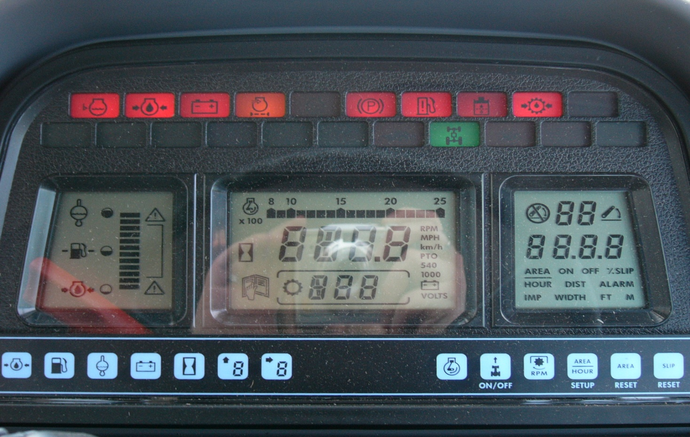
Do You Know What These Indicator Lights Mean?

Slide 4
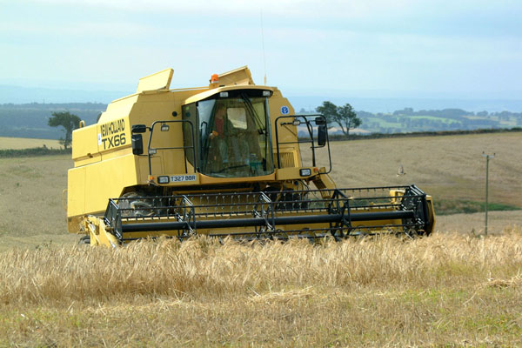
Purpose of Class
Application of owner’s manual to a specific tractor or piece of equipment
Working understanding of tractor instrument panel

Slide 5
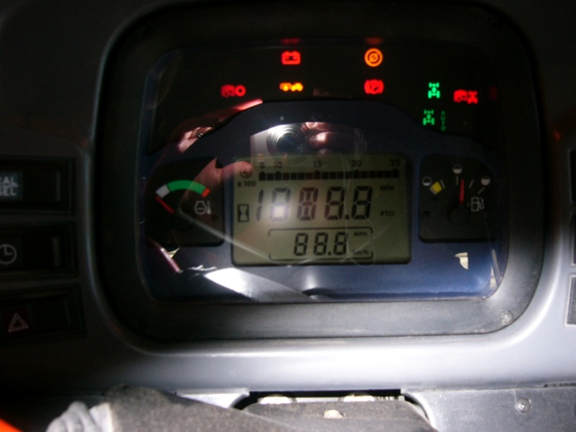
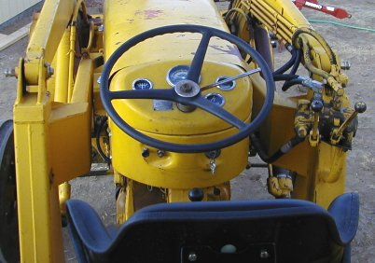
Why Are Instrument Panels Important?
Today’s Instrument Panels
Courtesy New Holland, Corvallis OR
Instrument Panels of the Past
Donandcarla.com

Slide 6
Effects Of A Careless Operator
www.osh.dol.govt.nz/kidz/gore/tractor.html

Slide 7
What Can You Learn From An Instrument Panel?
How much fuel is remaining?
Is the engine temperature normal?
When does the oil need to be changed?
Is the electrical system working?
Are the brakes engaged?

Slide 8
Gages And Instruments
Location of each gage
Normal readings
Function of each gage
Courtesy New Holland, Corvallis OR

Slide 9
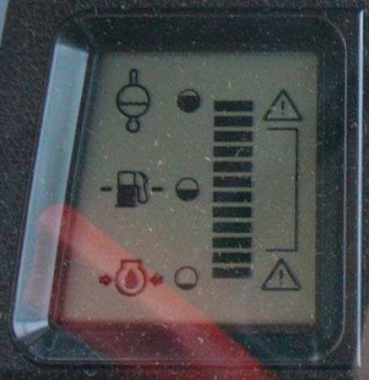
Fuel Gage
-Quantity of fuel in tractor
-Especially important in diesel engines
Courtesy New Holland, Corvallis OR

Slide 10
Charge Indicator
Is the alternator charging the battery?
What will happen if the battery is not charging?
Courtesy New Holland, Corvallis OR

Slide 11
Temperature Gage
Engine temperature
Proper range of working temperatures
Gas: 165º - 185º
Diesel: 180º - 210º
Indicator of potential problems
www.cummins.com/na/pages/en/prod

Slide 12
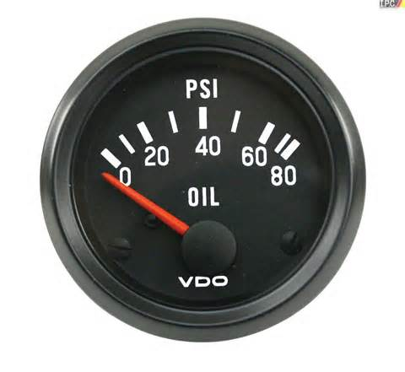
Oil Pressure Gage
Proper oil pressure range
Whether there are obstructions in oil line
Correct quantity of oil
Taylorcraft.org

Slide 13
Tractor Controls
Understanding allows safe tractor operation
Necessary to maximize use of tractor
Enables smooth and comfortable utilization of tractor

Slide 14
Brakes
Locked
Unlocked
Parking
Basic maintenance

Slide 15
Clutch
Hand
Foot
Hydraulic
Manual

Slide 16
Three-point Hitch
Safe operation
Used for attachments on tractor

Slide 17
Power Take Off (PTO)
SAFE OPERATION
Different uses
How to engage/ disengage
Oregon State University Dairy

Slide 18
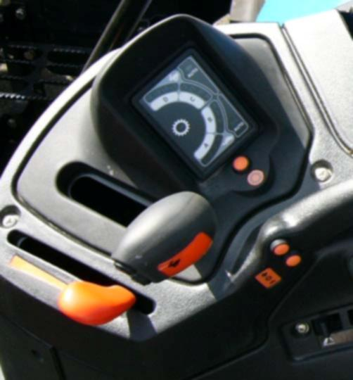
Throttle
Foot
Hand
Purpose
Courtesy New Holland, Corvallis OR

Slide 19
Accessories
Seat adjustment
Lights
Turn signals
Radio
http://newholland.com/h4/products/

Slide 20
Owner’s Manual
Location of manual
Use it before you need it
Service numbers
How to replace lost or damaged manuals

Slide 21
Conclusion
A working knowledge of gages and instruments is an important part of maintaining a safe, functioning tractor and operator
Understanding the owner’s manual will save time and money

