Slide 1
Chapter 16
Vegetative Growth

Slide 2
Plant Growth
Irreversible increase in volume and/or weight.
Occurs by increase in cell numbers and cell size.
Cell division and enlargement involves production of new cellular materials.

Slide 3
Primary and Secondary Growth
Primary Growth—occurs in young, herbaceous organs, resulting in longer shoots/roots.
Secondary Growth—follows primary growth, resulting in increased girth (layers of woody tissue)
Monocots/herbaceous dicots—typically exhibit only primary growth

Slide 4
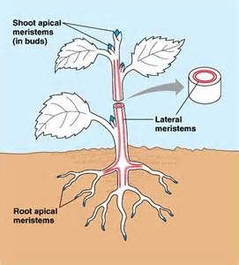
How Growth Occurs
Meristems—where new cells are formed
Apical meristem—at tip (apex) of each stem and root;
Primary meristems—
Primary tissues- cortex, primary xylem/phloem (vascular tissues)

Slide 5
Steps of Germination— Sprouting of Seed
STEP 1: H₂O absorption
STEP 2: Enzyme activation
STEP 3: Hydrolysis and use of stored compounds.
STEP 4: Initiation of embryo growth
STEP 5: Formation of new cell structures
STEP 6: New seedling emerges

Slide 6
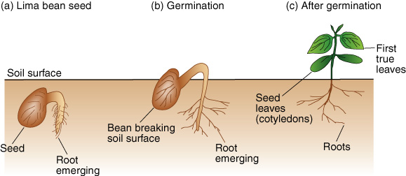
Lima Bean Germination

Slide 7
Environmental Factors Affecting Germination
H₂O—adequate, continuous supply
Light—can stimulate or inhibit germination
O₂—respiration rate increases during germination
Heat—favorable temperature (generally 65 to 75 degrees Fahrenheit)

Slide 8
Dormancy Requirements:
Some seeds require more dormancy than others:
Seeds lacking true dormancy—common vegetable garden seeds; ready to sprout, just need H₂O and warm-enough temperatures
Seeds endowed with deeper forms of dormancy—often taken from the wild

Slide 9
Seeds with Truly Dormant Embryos
Thick seed coat—keeps H₂O out, but scarification allows thick-coated seeds to germinate (strawberries and raspberries)
Thin seed coat—no barrier to water, but will germinate with right kind of light

Slide 10
Seeds with Truly Dormant Embryos (continued)
Insufficient development—if embryo is immature, it may need some additional maturation before it can sprout
Inhibitors present
abscisic acid: delays sprouting until spring
Phenolic compounds: desert plants

Slide 11
Shoot Growth Classification:
Determinate—after period of vegetative growth, flower clusters form at shoot terminals; example: many vegetables
Indeterminate—flowers cluster laterally along stem and in axils of leaves so shoot terminals remain vegetative; examples: pole beans and grapevines

Slide 12
Annuals, Biennials, Perennials
Annuals—complete life cycle in less than one year; must be planted again; herbaceous
Biennials—complete cycle in two growing seasons; herbaceous
Perennials—continue to grow for more than two years; herbaceous or woody

Slide 13
Factors Affecting Plant Growth
Soil conditions
Water use and requirements
Nutrients
Temperature
Light
Pests (weeds, insects, disease)
Plant growth regulators and hormones

Slide 14
Plant Life Phases
Embryonic growth
Juvenility—unable to form flowers/fruit
Maturity—produces flowers, fruit, seeds
Senescence—terminal, irreversible deteriorative change in living organisms leading to cell breakdown
Death

