Slide 1
Concepts of Landscape Design

Slide 2
Why Landscape?
Landscape design exists for many reasons, including…
Increasing your home’s property value. Landscaping can raise the value of a home 10-30%. For a $200k home, this translates to tens of thousands of dollars in profit
Energy Efficiency – a well-landscaped home is cheaper to cool in summer and easier to warm in winter. Landscaping reduces heat loss in winter while reducing heat exposure in summer.

Slide 3
Why Landscape?
It helps the planet – in addition to reducing the energy use of your home, landscaping can serve as a buffer between the environmental impact of your home and the natural world around it.
It improves your health and well-being – landscaping, when done well, reduces stress and anxiety while providing you with a place to “escape” from the hustle of modern life.

Slide 4
What is Landscape Design?
Landscape Design is the coordinated and sustainable use of plant life and materials to create a functional, easy-to-manage outdoor environment in which to live, work, and play.
It combines the use of principles of design, ecology, budgeting and finance, construction, and psychology to create please outdoor spaces that serve as a buffer between civilization and the natural world.

Slide 5
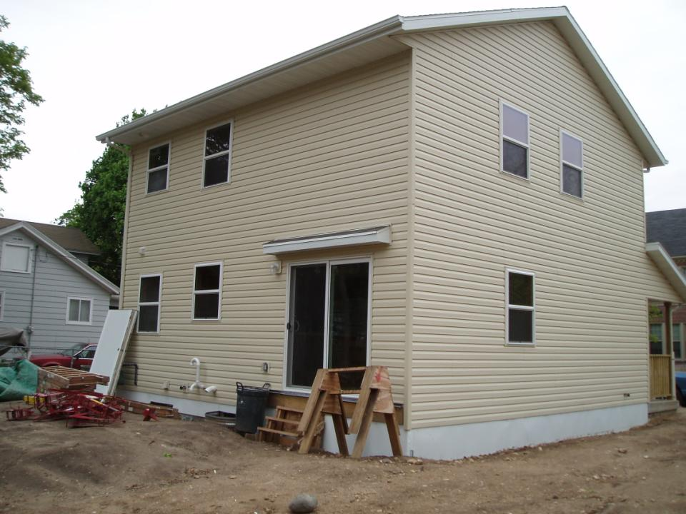
Would you want to live here?

Slide 6
Landscape Elements
Landscape Design entails several key elements that are universal to all design projects, regardless of if they are for a home, business, or park.
These include –
Focal Points
Line
Form
Texture

Slide 7
Focal Points
The focal point is the point or area of the landscape that attracts the viewer’s eyes.
The lines, form, and texture of a landscape design attract the attention of the viewer and draws it to the focal point.
Without a point or area on which to focus, the viewer’s eyes become lost and confused throughout the landscape.

Slide 8
Focal Points
As a designer, create an accent or focal point that is strong and effective.
Do not incorporate too many focal points into the landscape.
Otherwise, their effect will be lost.
Use the design elements (line, form, texture) to move the viewer’s eyes through the landscape to the place of the focal point.

Slide 9
Find the Focal Point…

Slide 10
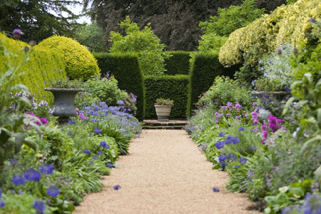
Find the Focal Point…

Slide 11
Focal Point??

Slide 12
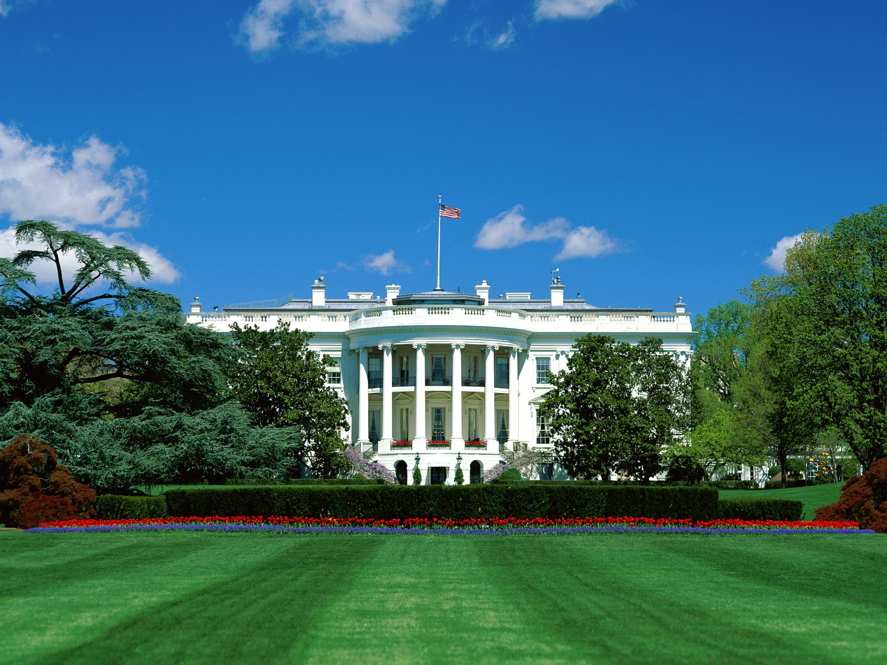

Slide 13
Line
Line plays an important role in a landscape.
Line is the formation of boundaries in a landscape through changes in color, substance, form, or texture. It is where one element meets a different kind of element.
Line leads the viewer’s eyes through the landscaped space.
It defines and creates space and order.
A skilled designer recognizes the use of line. He/she applies line in all aspects of the landscape.
Source: Texas A&M

Slide 14
Incorporation of Line
As a designer, incorporate line into a landscape by using contrasting plant material and by forming patterns with similar plant materials.
Pattern is line organized in a repetitive sequence.
Examples of lines created in a landscape include ground patterns, edges of contrasting plant materials, and tree tops meeting the sky.
Source: Texas A&M

Slide 16
Line Type
Use line to draw attention to highlights in your landscape. DO NOT use lines in a manner that draws attention out of the landscape and into the sky or surrounding territory.
Use straight lines to represent formality or a contemporary concept. Intersecting straight lines suggest hesitation, change of view or direction, or a pause.
Meandering or curved lines suggest a more relaxed, slower movement. Use these to create a casual, informal concept.
Source: Texas A&M

Slide 17
Sustainable Landscape Design
Lines

Slide 18
Sustainable Landscape Design
Lines

Slide 19
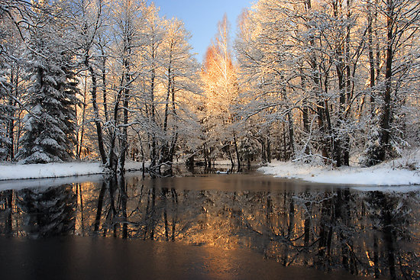

Slide 20
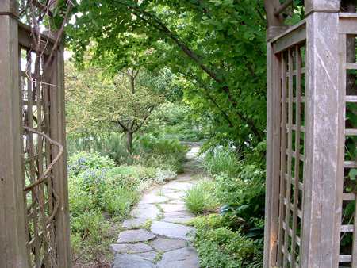

Slide 21
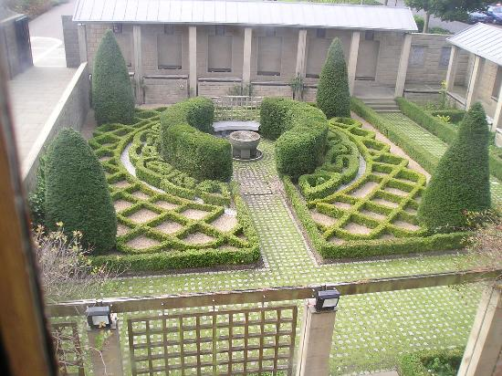

Slide 22
Form
Form is the two or three-dimensional shape and structure of an object or space.
Whether it is two or three dimensional, form is line surrounding mass.
Most deciduous trees and shrubs have a rounded form.
A conical form is characteristic of many evergreen trees.
Evergreen shrubs have more of a horizontal form.
Source: Texas A&M

Slide 23
Form and Informal Form
Formal concepts suggest the use of very tailored forms of plant material and ground beds.
Such a formal landscape would include very straight, crisp, and precise planting beds; topiaries; and other visually clean-lined plants.
Informal or woodland concepts mandate much more irregular or natural forms.
Casual curving ground beds and loosely branched trees and vines have forms to satisfy this concept.
Source: Texas A&M

Slide 24
Application of Form
As a designer, incorporate form into a landscape to manipulate a person’s emotions.
Use vertical forms for strong accents and for adding height.
Horizontal or spreading forms add visual width to tall structures.
Incorporate weeping or drooping forms to create soft lines and to provide a transition to the ground plane.
Rounded plant forms create large masses and are effective as borders and enclosures.
Consider the element of form when making design decisions regarding design details for plants, structures, and ground patterns.
Source: Texas A&M

Slide 26
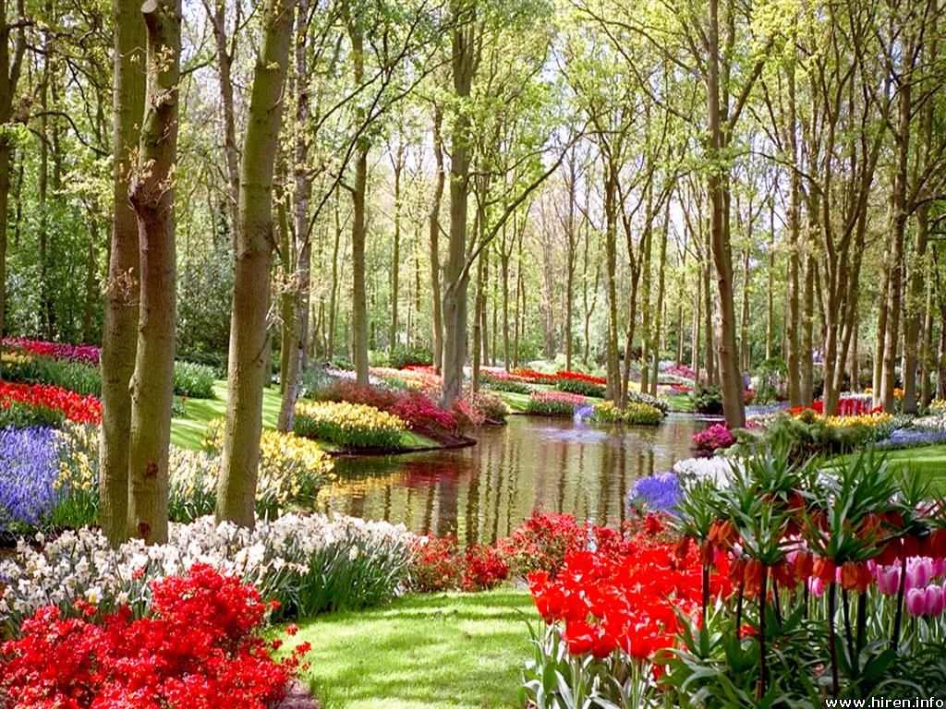

Slide 27
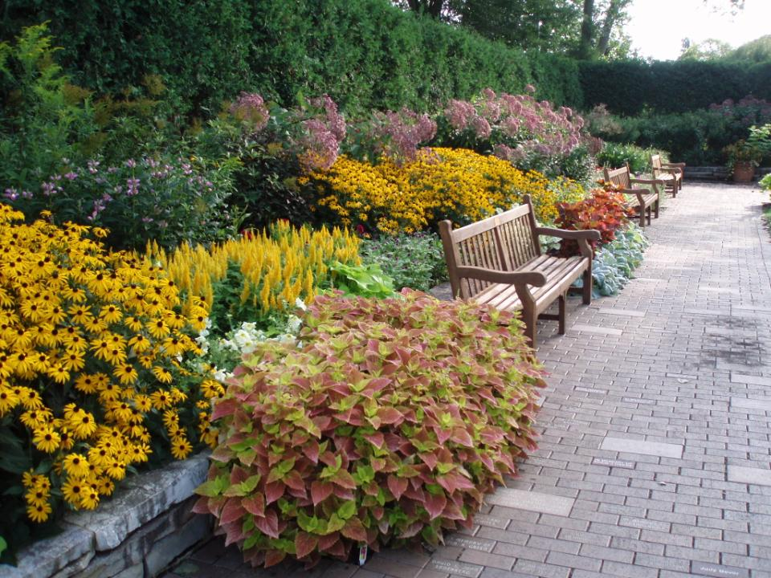

Slide 28
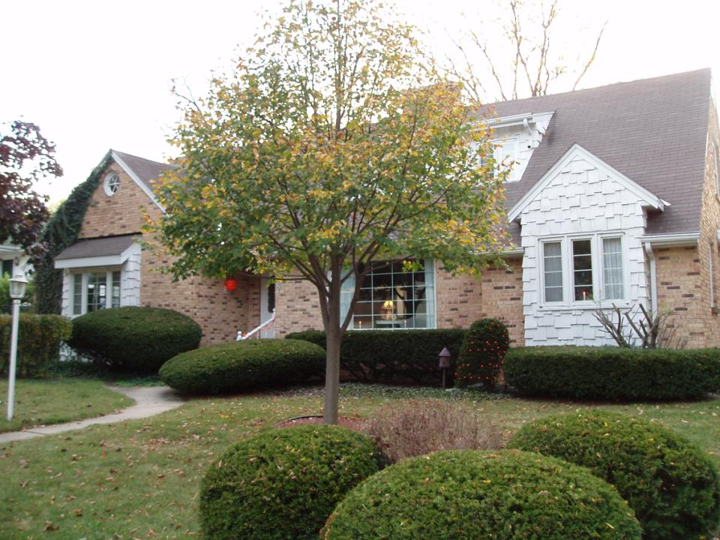

Slide 29
Texture
Texture is the surface quality of any plant material or structure in the landscape.
It is the feature of a plant or structure’s physical surface qualities as determined by form and size.
E.g. grass has a very smooth texture – it looks like a smooth mat of green
E.g. palm trees have a very rough texture – their large leaves are very individually evident

Slide 30
Texture is Relative
Texture is relative – what may be a fine texture in one case could become course in another design.

Slide 31
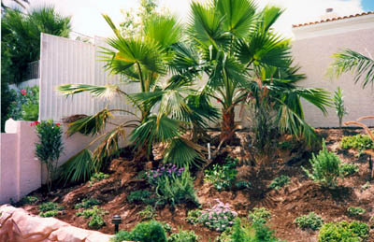
Course Texture
Visually coarse textures have border impacts. Coarse textures keep the viewer’s eyes busy.
The coarse textured plant materials appear to advance toward the viewer, making a large space seem smaller and more intimate.

Slide 33
Fine Texture
Finer textures are easier for the viewer’s eyes to look at.
With finer textures, the eyes continue searching for an accent on which to focus.
Fine textured plant materials visually recede and appear farther away. They make an area seem larger and more expanded.

Slide 35
Conclusion
Landscape design should be designed – a design should not happen by accident but should be the result of coordinated and intentional plantings and arrangements.
Focal points, line, form, and texture should be combined to direct the viewer’s eye.
These elements should be considered, planned, and evaluated prior to any actual work.
Next Week – Principles of Design – the design components that are a part of any effective landscape.

