Slide 1
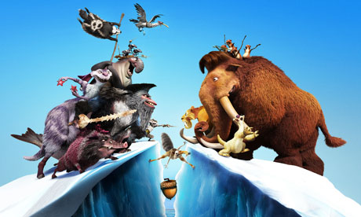
Continental Drift

Slide 2
Evidence for Continental Drift
How could a fossil of a Tyranasaurus Rex be found in North America and also in Europe?
A T-Rex could not swim.
A T-Rex could not have crossed the Atlantic Ocean.
How could this be possible?
What about the theory of Continental Drift?

Slide 3
Continental Drift
The theory of Continental Drift is based upon the concept that the Earth’s continents have moved relative to each other over time.
If they have moved, where did they start???
What would explain this movement???
What about the theory of Pangea?

Slide 4
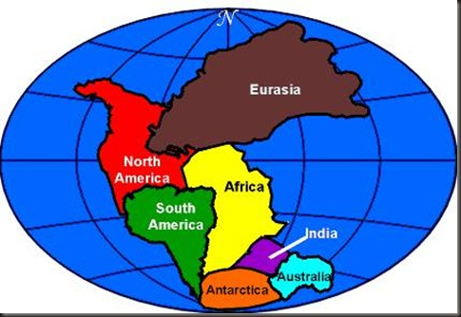
Pangea

Slide 5
Pangea
The theory of Pangea states that the Earth’s 7 continents were once joined together as one solid land mass.
The theory of Pangea gives support to the theory of Continental Drift.
Lets watch a short video explaining the theory of Pangea. It will only take about 10 minutes.
https://www.youtube.com/watch?v=3HDb9Ijynfo

Slide 6
What caused the continents to drift apart?

Slide 7
What caused Pangea to break apart?
There were natural forces occurring on Earth in pre-historic times that caused Pangea to split apart.
Those same natural forces are still affecting the Earth’s land masses and oceans today.
These forces are explained by a concept called Plate Tectonics.
We will discuss Plate Tectonics in greater detail tomorrow.

