Slide 1
Ecoscenario Project
Individual Report Guidelines

Slide 2
Individual Report
Each group member is responsible for doing extensive research on a population found within their ecosystem they are researching.
Each group must research a Producer, a Primary Consumer, and a Secondary Consumer.

Slide 3
What you will do:
Describe a population’s role within the ecosystem-
Where it lives
What it eats
Any important interactions w/ other animals
Important behaviors…
Discussion population’s abiotic needs & interactions.
Give an example of human impact on the population.

Slide 4
What to include:
Any pictures, graphs, etc. to make your information easier to understand.

Slide 5
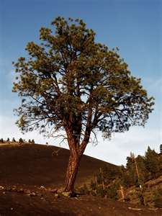
How long should it be?
It depends on what you need to say…
Most individual projects last year were 2.5-3 pages in length.

