Slide 1
Day 2: Scientific Inquiry

Slide 2
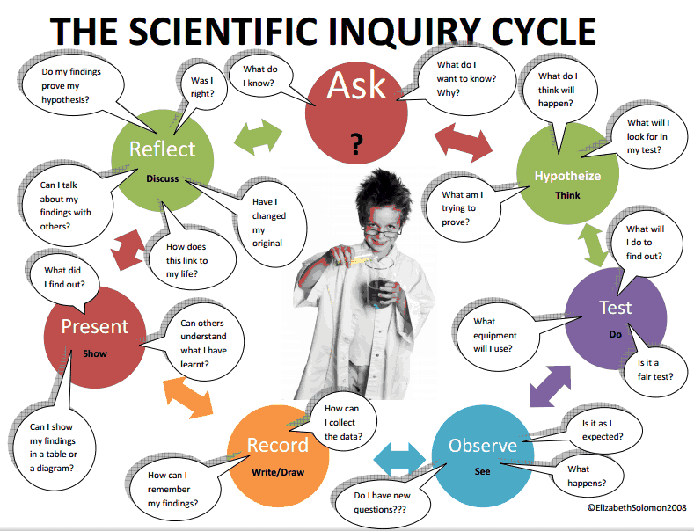
What is Scientific Inquiry?
Scientific Inquiry is the diverse ways scientists study the natural world and propose explanations based on the evidence that they gather.

Slide 3
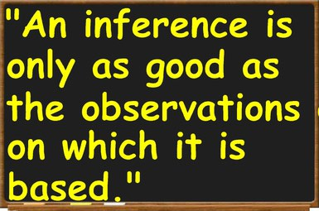
What is an inference?
Explaining or interpreting an observation. Inferences must be reasonable and based on evidence.

Slide 4
Observation 1: The cattle and the antelope are standing quietly together.
Reasonable inference 1: The cattle and the antelope do not attack each other.
Unreasonable inference 1: None of the animals in this region attack each other.

Slide 5
Observation 2: Some of the cattle are eating grass.
Reasonable inference 2: The grass is food for the cattle and antelope.
Unreasonable inference 2: Most of the grass in this area is eaten by the cattle.

Slide 6
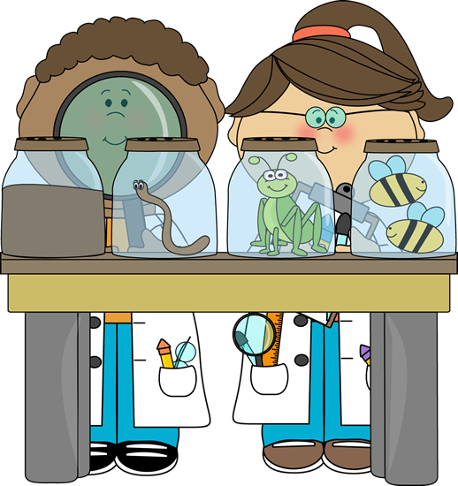
The Scientific Method
Step 1: Make an observation

Slide 7
The Scientific Method
Step 2: State the Problem after making an observation.
This is written in the form of a question.
Example: Which of these two paper towel brands will absorb more water?

Slide 8
The Scientific Method
Step 3: Form a Hypothesis
A hypothesis is a possible answer to your question. It is usually based on the inference made from the observation!
It is a testable statement (more on this later…)
Example: If Bounty is thicker than Scott, then Bounty will absorb more water.

Slide 9
The Scientific Method
Step 4: Perform an Experiment to test the hypothesis.
Example: How would you test which paper towel will absorb more?
Spread out a certain amount of liquid
Use the paper towel to pick up as much as you can
Measure how much is left over

Slide 10
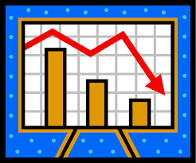
The Scientific Method
Step 5: Collect and Analyze the Data
Includes creating tables or graphs to look for trends.

Slide 11
The Scientific Method
Step 6: Draw a Conclusion
Here you look at the data from the experiment to see if your hypothesis was correct or incorrect.

Slide 12
Scientific Method Example
Observation: My car won’t start.
State the problem: Is my car out of gas?
Hypothesis: If I put gas in my car, then it will start.
Experiment: First, I get a ride to the gas station. I purchase 5 gallons of gas. Then I return to my car and put the gasoline in the tank. Once the gasoline is in the tank, I will attempt to restart the car.
Analysis: I note my car started after I put in gas.
Conclusion: My car wouldn’t start because it was out of gas.

